Slide 1



CSA0803
PERSONAL EXPENSE TRACKER WITH
DATA VISUALIZATION
Student name: Paul Davidson Glory Andrea Beryl Devadharshini Murugesh Gokul JAICHITRA
Register number: 1972260007 1971260011 1925260001 1971260009 1925260017
Subject: Python programing (SLOT A)
Faculty Name: Dr. Samson Ebenazar

Slide 2
ABSTRACT
The Personal Expense Tracker with Data Visualization is a Python-based application designed to simplify and improve personal financial management. Managing daily income and expenses manually can be time-consuming, difficult to organize, and prone to calculation errors. The proposed system provides a simple and user-friendly platform where users can record, categorize, update, delete, and search their financial transactions. The application is developed using Python, with Tkinter used to create the graphical user interface, SQLite used for reliable storage of financial records, and Matplotlib used for data visualization. The system categorizes expenses into areas such as food, travel, shopping, bills, education, and entertainment, allowing users to understand their spending patterns more effectively. Pie charts display category-wise expense distribution, while bar graphs provide a comparison of monthly expenses. The system also calculates total income, total expenses, and remaining balance to provide a clear financial summary. By combining database management with graphical visualization, the application reduces manual calculations and improves record organization. Overall, the project demonstrates the practical application of Python programming, GUI development, database management, and data visualization to create an efficient and accessible personal finance management solution.
Notes:
Hospitals often face bed shortages and overcrowding in emergency departments. Our project provides a C++-based system that tracks bed availability in real time and allocates beds based on patient priority. It improves resource management, reduces delays, and helps doctors and administrators make faster decisions.

Slide 3
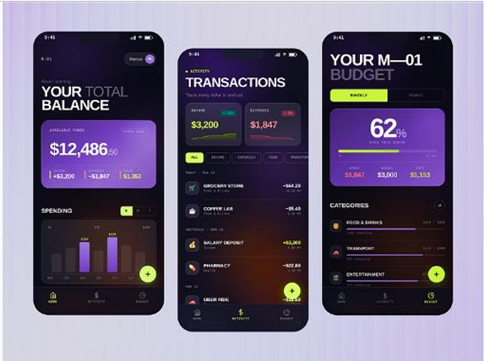
INTRODUCTION
Managing money effectively is important for maintaining financial stability. Traditional methods such as notebooks or spreadsheets can be time-consuming and may make it difficult to identify spending patterns.
The Personal Expense Tracker provides a simple digital solution for recording income and expenses. Users can categorize expenses such as Food, Travel, Shopping, Bills, Education, and Entertainment. The system stores the records in an SQLite database and provides graphical visualization of spending.
The project demonstrates the practical application of Python programming, GUI development, database management, and data visualization.
Notes:
Hospitals often face bed shortages and overcrowding in emergency departments. Our project provides a C++-based system that tracks bed availability in real time and allocates beds based on patient priority. It improves resource management, reduces delays, and helps doctors and administrators make faster decisions.

Slide 4

LITERATURE SURVEY (2022-2026)
S.No | Author Name | Year | Method / Focus | Pros | Cons
1 | S. Kumar et al. | 2026 | AI-assisted personal finance and expense analysis | Personalized financial insights; automated analysis | More complex implementation
2 | A. Sharma et al. | 2025 | Machine-learning-based personal expense classification | Automatic categorization; improves expense analysis | Requires sufficient training data
3 | R. Patel et al. | 2024 | Mobile-based personal expense tracking system | Easy access; convenient daily tracking | Limited advanced visualization
4 | M. Singh et al. | 2023 | Web-based budget and expense management | Centralized records; budget monitoring | Requires web infrastructure
5 | P. Raj and S. Devi | 2022 | Digital personal finance management using databases | Organized storage; simple record management | Mostly focused on manual data entry
Notes:
Recent studies explored reinforcement learning and autonomous AI systems. While these methods improve emergency response, they require high computing power and raise security concerns. Our project instead uses efficient heuristic logic and localized encrypted databases to keep the system simple and secure.

Slide 5
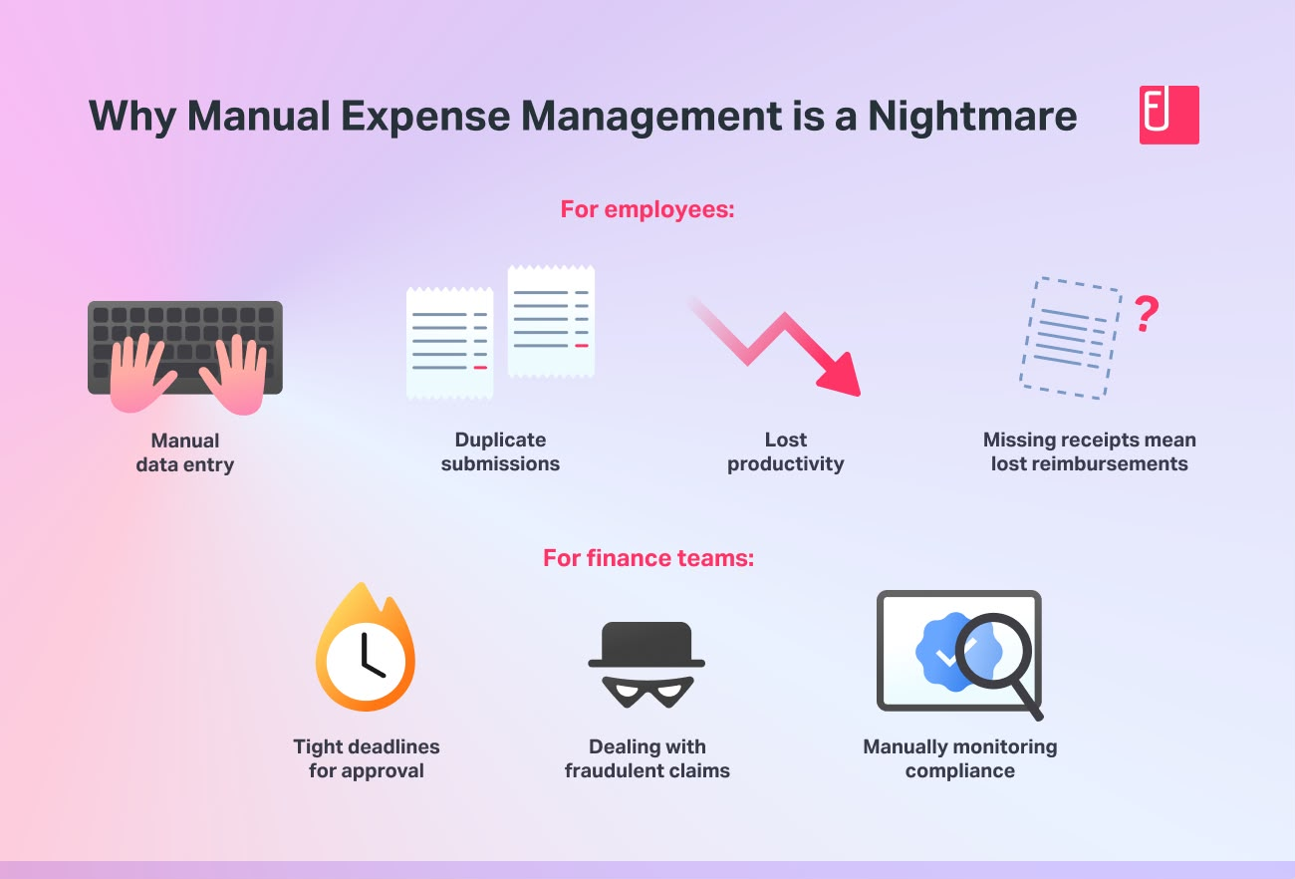

SUMMARY OF CONS
Manual expense tracking can lead to data-entry errors.
Spreadsheet-based systems require continuous manual maintenance.
Advanced applications may be complicated for beginners.
Some systems require internet connectivity.
Complex financial applications may require additional infrastructure.
Spending patterns may be difficult to understand without visualization.
Maintaining records manually can be time-consuming.
Notes:
Existing systems have several drawbacks: manual tracking errors, high implementation costs, poor integration between departments, dependence on technology without solving logistical issues, and slow response during emergency surges. Our project addresses these problems with a simple OOP-based approach.

Slide 6
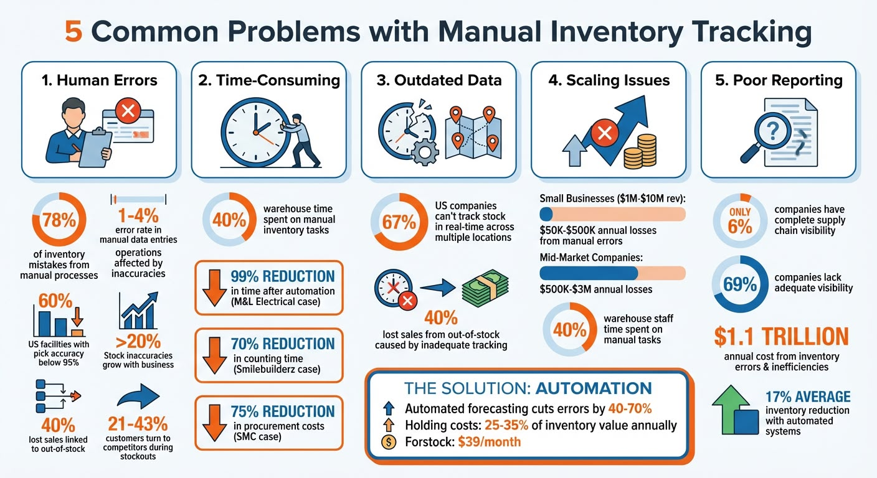
ISSUES IN THE EXISTING MODEL
Manual Tracking: Users need to enter and calculate expenses manually.
Poor Visualization: Traditional records do not clearly show spending patterns.
Time Consumption: Preparing monthly summaries takes additional effort.
Data Organization: Finding a particular expense can be difficult.
Calculation Errors: Manual calculations may result in incorrect totals.
Limited Analysis: Users may not easily identify their major spending categories.
Notes:
Existing systems have several drawbacks: manual tracking errors, high implementation costs, poor integration between departments, dependence on technology without solving logistical issues, and slow response during emergency surges. Our project addresses these problems with a simple OOP-based approach.

Slide 7
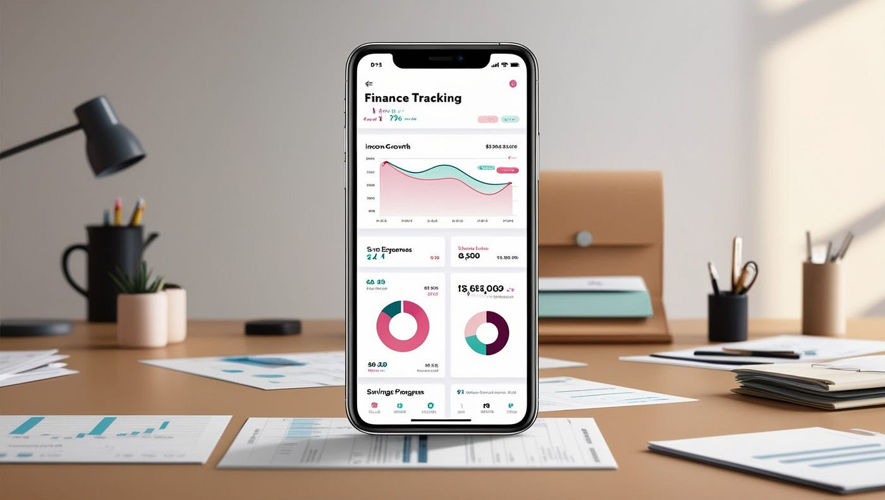
PROPOSED SOLUTION
Develop a Python-based expense tracking application.
Store financial records using SQLite database.
Provide an easy-to-use Tkinter GUI.
Allow users to add and manage income and expenses.
Categorize expenses for better organization.
Generate pie charts and bar graphs for analysis.
Provide search and filtering facilities.
Generate financial summaries to understand income, expenses, and balance.
Notes:
The main aims are to automate emergency bed allocation, integrate patient and resource data, provide a cost-effective solution using C++, and allocate resources based on patient priority.

Slide 8

AIM OF THE PROJECT
The primary aim of the Personal Expense Tracker with Data Visualization is to provide a simple and efficient system for recording, organizing, and analyzing personal financial transactions.
The project aims to:
Track daily income and expenses.
Categorize spending.
Reduce manual calculation.
Analyze spending patterns.
Display financial information visually.
Help users make better budgeting decisions.

Slide 9
MODULES OF THE PROJECT
6. Report Generation
Total income
Total expenses
Remaining balance
Monthly summary
7. System Exit
Store records using SQLite
Retrieve and update data
1. User Authentication
User registration
Secure login
User validation
2. Pipeline Management
Add income
View income records
Track income sources
3. Water Distribution Management
Add expenses
Edit/delete records
Categorize expenses
4. Leakage Detection
Search expenses
View transaction history
Filter records
5. Database Management
Category-wise pie chart
Monthly expense bar chart
Spending analysis

Slide 10

CONCLUSION
The Personal Expense Tracker with Data Visualization provides a simple and efficient solution for managing personal finances. It combines Python programming, database management, GUI development, and data visualization to record and analyze financial transactions.
By categorizing expenses and presenting them through charts, the system makes financial information easier to understand. The project reduces manual calculations, improves record organization, and helps users identify their spending patterns. Overall, it demonstrates how a simple software application can support better personal financial management.
Notes:
ur system has four modules:
Patient Registry – Stores patient details and priority.
Resource Manager – Monitors beds and equipment.
Emergency Allocator – Assigns beds based on urgency.
Discharge Planner – Updates bed availability after discharge. Together, these modules ensure efficient hospital management.

Slide 11
REFERENCE
M. Fahlevi, M. Dandi, S. Dahlan, and O. P. Dahlan, “The Impact of Digital Financial Literacy on Savings, Expenditure, and Prospective Financial Behavior: An Exploratory Inquiry,” 2024 9th International Conference on Business and Industrial Research (ICBIR), 2024.
“Artificial Intelligence/Machine Learning Driven Decision Making in Business Analytics for Financial Sector Using Ensemble Machine Learning Techniques,” IEEE, 2024.
E. Johri, P. Desai, P. Soni, H. Jain, and N. Sanganeria, “Expense Management System,” 2023 4th IEEE Global Conference for Advancement in Technology (GCAT), 2023, DOI: 10.1109/GCAT59970.2023.10353348.
Notes:
ur system has four modules:
Patient Registry – Stores patient details and priority.
Resource Manager – Monitors beds and equipment.
Emergency Allocator – Assigns beds based on urgency.
Discharge Planner – Updates bed availability after discharge. Together, these modules ensure efficient hospital management.

